Slide 1

Simplex Algorithm for Linear Programming: The Implementation
You need to have understood the video on Introduction to the Optimization and Linear Programming concepts and approaches
This video focuses on turning the approaches into an actually implemented algorithm
We assume the problem has been converted to standard form

Slide 2
Moving Along an Edge: Varying Two Slack Variables
Remember that
For each constraint there is a slack variable
When the slack variable is zero, we are at a constraint extreme
Each step from a vertex to another vertex involves releasing one of the constraint extremes and moving to a different constraint extreme
That is, the step involves increasing from zero the slack variable corresponding to the constraint extreme released until the slack variable for the new constraint extreme is decreased until it becomes zero
We thereby arrive at the next vertex
Space satisfying constratints. From MathWorld – A Wolfram Web Resource.

Slide 3
Moving Along the Next Edge: Varying Two New Slack Variables
Having arrived at that new vertex, we choose a new edge from that vertex. As with the previous edge, along the edge there are two constraint extremes involved, each with an associated slack variable
One which is increased from zero
One which decreases until it becomes zero
Space satisfying constratints. From MathWorld – A Wolfram Web Resource.

Slide 4
All Variables Can Be Considered Slack Variables
There are m constraints with explicitly associated slack variables
Besides these there are the n variables x_{i} that are required to be ≥ 0
That is, each can also be considered a slack variable, with the extreme being 0, just like the other slack variables
And each, when = zero, also provides a hyperpolyhedral edge that can be moved along in an optimization step
Space satisfying constratints. From MathWorld – A Wolfram Web Resource.

Slide 5
The Constraints Maintained When Moving Along an Edge
A vertex involves
n variables that are zero
These variables are called the “basic” variables
The objective function and constraints are in terms of them
Initially the basic variables are the n x_{i}
An edge involves
n-1 variables that are zero and remain zero
One variable that starts out at zero but is increased
This is called the “leaving” variable; it leaves the basic set
One variable that starts out >0 but decreases to zero when we arrive at the next vertex
This called the “entering”variable; it joins the basic set

Slide 6
All Variables Are Slack Variables
We now have n+m variables
All the constraints are now of the same form, namely x_{k} ≥ 0, k=1,2,…,n+m.
Any of the n+m variables (all behaving like a slack variable) can be among the n+1 variables in question
At any stage n of the variables are basic, m are non-basic
Identifying an edge to traverse can be restated as indentifying a leaving variable that will change its status from basic to non-basic and an entering variable that will change its status from non-basic to basic

Slide 7
The Processes of the Simplex Algorithm
The m nonbasic variables x_{q} are related to the basic variables x_{i} as a linear combination of them: x_{q} = b_{q} -Σ_{i} A_{qi} x_{i}
The objective function is written as a linear combination of the basic variables x_{i} : Σ_{i} c_{i} x_{i}
The processes of the simplex method are successively
Identifying each new edge, i.e., a (leaving variable, entering variable) pair
Changing the status of the two variables
Changing the status of the two variables means
Computing a whole bunch of coefficients: A_{qi}, b_{q}, and c_{i} to become written in terms of the new basic variables
This computation is called “pivoting”

Slide 8
The Processes of Pivoting
Before pivoting we have
The objective function coefficients c_{i} of the basic variables
Each non-basic variable’s coefficients A_{qi} and b_{q} of the basic variables
Given a leaving (basic variable) x_{k} and an entering (non-basic) variable x_{j}, changing the status of the two variables means
Computing the coefficients of the remaining non-basic variables in terms of the new set of basic variables
Computing the coefficients of the leaving (new non-basic) variable in terms of the new set of basic variables
Computing the coefficients of the objective function in a way no longer involving the leaving variable and now including the entering variable

Slide 9
Computing the New Coefficients in Terms of the New Basic Set
Coefficients of leaving variable x_{k}, becoming non-basic
We have an equation for the entering variable x_{k} in terms of the old basic variables x_{i}
Solve it for x_{k} in terms of the old basic variables
This is the result we need
Coefficients of the remaining non-basic variables x_{q}
We have an equation for each remaining x_{q} in terms of the old basic variables x_{i}
Substitute the solution for x_{k} in terms of the old basic variables (see above item) into the x_{q} equations, and collect terms to obtain coefficients of each x_{i} in the new basic set
Coefficients of the objective function
Substitute the solution for x_{k} in terms of the old basic variables into the objective function, and collect terms to obtain coefficients of the objective function

Slide 10
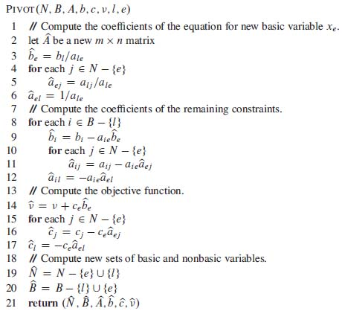
Pivoting
Pivoting is recasting the constraints and objective function, given an entering variable to move along and a leaving variable which is no longer involved the constraints relevant to this step.
UNC Chapel Hill
Notes:
10

Slide 11
Optimizing the n+m Variables
The n variables in the objective function and the m variables on the left side of the contraint equations are non-overlapping subsets of the n+m total variables
Each vertex-to-adjacent-vertex move optimizes the objective function over a single one of the basic variables, namely the leaving variable, which you will be increasing from zero
Thus, in obtaining a maximum, you want a leaving variable (from among the basic set) that has a positive coefficient in the objective function; any one will do
If none of the basic variables has a positive coefficient in the objective function, it can be shown that the maximum has been reached

Slide 12
Finding the Leaving Variable in a Single Optimization Move
Having chosen x_{k}, increasing it and thus the objective function until some other variable x_{j} becomes 0.
We will then be at a new vertex.
x_{j} is one of the non-basic variables, written in terms of the basic ones
So for any leaving variable x_{k}, the corresponding entering variable x_{j} is the one with the tightest constraint
That is to say, it is the one, among all of the non-basic variables, with the most negative coefficient -A_{qk} of x_{k} relative to its b_{q} value in those non-basic variable’s equations in terms of the present basic variables
In that equation setting x_{j} to zero and solving for x_{k} gives the allowed increased value of x_{k}

Slide 13
Successive Moves in Optimization
At each stage choose a basic variable (one in the objective function) with positive coefficient. Let that be the leaving variable.
Then choose the most constraining non-basic variable. Let that be the entering variable.
The constraint on the entering variable (initially non-basic) creates the new value of the leaving variable (initially basic) by the solution of its equation.
Then pivot to the new set of variables, and iterate
Until the pivoted objective function has only negative coefficients

Slide 14
Aspects of the Simplex Algorithm
Feasibility
Are there are any constraint-satisfying solutions at all?
Unboundedness
Is the top of the polyhedron along the c direction is closed? (If not the optimum has an infinite objective function value, and it occurs nonuniquely.)
Choosing entering and leaving variables
Finding the next edge piece to traverse at each step
Termination
Checking whether we are at the optimum: objective function having no positive coefficients..
Initialization
Finding an initial vertex to start at. We will discuss that in a later slide on initialization.

Slide 15
Choosing Entering and Leaving Variables and Check for Termination
Choosing entering and leaving variables
Really any basic variable with a positive coefficient will do for a leaving variable; you could choose the one with the biggest coefficient in the objective function
The corresponding entering variable is done by a minimization wrt the nonbasic variables’ constraints
If there are two variables providing equally tightest constraints, choose one.
Termination: Checking whether we are at the optimum
Check when all coefficients in the objective function are negative
UNC Chapel Hill
Notes:
15

Slide 16
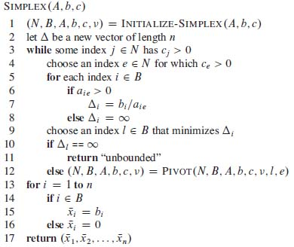
The Simplex Algorithm
A and b form constraints
c forms objective function
N is the list of nonbasic vbles
B is the list of basic vbles
ν is the objective function value

Slide 17
Initalizing the Simplex Algorithm
What would be nice is starting with all basic variables zero, so the objective function is zero
But this might not satisfy all of the constraints
Thus modify the slack variables so that zeros do satisfy the modified constraints, and optimize to create an initialization of the main Simplex
This initializing algorithm is accomplished by
Adding yet another nonbasic variable x₀ and adding –x₀ to each constraint before creating the slack variables
Making the objective function -x₀
Initializing the basic variables = 0
Running a whole new application of the Simplex algorithm
Doing a final pivot, if necessary, to make x₀ nonbasic
This yields the initial form of the main Simplex, once the objective function is modified acc. to how the basic variables came out in the initializing Simplex.
UNC Chapel Hill
Notes:
17

Slide 18
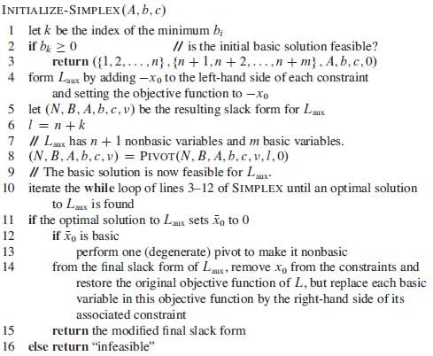
Initializing Simplex
A and b form constraints
c forms objective function
N is the list of nonbasic vbles
B is the list of basic vbles
ν is the objective function value
UNC Chapel Hill
Notes:
18

Slide 19
Proof of Achievement of Optimality (of Objective Function, not in time)
Done by looking at an equivalent problem, the dual, in which
The problem is turned to minimization
The constraint constants and the objective function constants change roles
We will not cover that proof (nor will it be examined, even though it is in the assigned reading). COMP 750 covers that proof.

Slide 20
Time Analysis of Simplex Algorithm
Worst case is non-polynomial
Each step (vertex move) is Θ(mn): polynomial.
The number of pivoting steps needed is what can be non-polynomial
Frequently fast
There exist guaranteed polynomial algorithms, though they may often be slower than Simplex
UNC Chapel Hill
Notes:
20

Slide 21
Alternatives to the Simplex Algorithm
There are whole courses on Linear Programming
See STOR courses
An interesting alternative is to approximate the linear problem by a nonlinear one in which the solution region is smooth, and then apply a method that optimizes the nonlinear problem
Using a form of the Newton-Raphson approach for optimization yields fast convergence
UNC Chapel Hill
Notes:
21

Slide 22
Worksheet on the Simplex Algorithm
How many basic variables are there at a vertex of the objective function polyhedron for a problem with n optimization variables and m constraints?
How many non-basic variables are there for the same optimization problem?
What is the criterion for choosing a leaving variable at a vertex?
What is the criterion for determining the entering variable corresponding to a given leavning variable
What is the criterion for termination of the algorithm?

Slide 23
Exercises
To be specified

